Slide 1
Vertical Slice Architecture
Zero to Hero
Brisbane .NET UG | October 2024

Slide 2
Agenda
Intro
History of VSA
Theory in depth
Demo – Simple CRUD
Demo – Tactical VSA
When should I pick VSA?
Conclusion

Slide 3
Agenda
Intro
History of VSA
Theory in depth
Demo – Simple CRUD
Demo – Tactical VSA
When should I pick VSA?
Conclusion

Slide 4


Luke Parker
Full Stack Engineer
@ Revive Financial
Deep diving architectures for ~5 years
Clean Architecture trainer
Speaker at DDD Brisbane, NDC Sydney & .NET Conf
Hona
lukeparker.dev

Slide 5
Agenda
History of VSA
Theory in depth
Demo – Simple CRUD
Demo – Tactical VSA
When should I pick VSA?
Conclusion

Slide 6
2015 - SOLID Architecture
https://vimeo.com/131633177
SRP - One class per feature/concept
OCP - Extend through cross-cutting concerns
LSP - Just don't do inheritance
ISP - Separating queries from commands
DIP - Save for true external dependencies.
Notes:
In fact, as early as 2015, Jimmy was talking about SOLID Architecture which is essentially the same thing. It had a few key points (from his slides):
The key points of the SOLID architecture were really applying the principals to achieve a highly cohesive codebase in regard to the Domain specific code (SRP, ISP).
The Domain specific code was then extended (OCP) via cross-cutting concerns - like authentication, authorization & generic logging.
A lot of the outcomes from this talk to me, was allowing a simpler architecture for what matters most - the Domain. The most important thing in software, is that it works. The architecture that allows you to deliver features quickly, is the best architecture for you.

Slide 7
2018 – Vertical Slice Architecture
https://www.jimmybogard.com/vertical-slice-architecture/
CQRS - e.g. HTTP GET is safe & idempotent, POST is Unsafe & not idempotent. Represent this two different concerns in different models/classes where this was just one.
Vertical Slicing makes it easy to modify code
Do not skip the refactor step in Red-Green-Refactor. (Common complaints about 'simple' architectures is due to this)
Push behaviour down (i.e. Focus on a rich domain & allow handlers to do the 'ugly' work, like data access)
Integration test handlers & unit test Domain

Slide 8
Agenda
History of VSA
Theory in depth
Demo – Simple CRUD
Demo – Tactical VSA
When should I pick VSA?
Conclusion

Slide 9
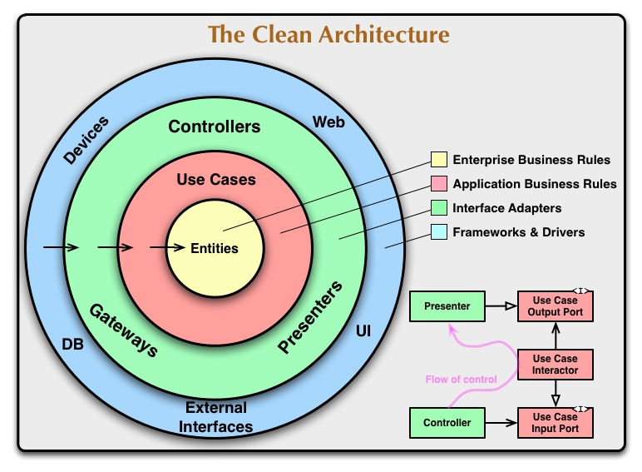
Notes:
While some arhcitectures use technical concern with dependencies flowing innerwards, a nice way is to think of VSA as logic/locality

Slide 10
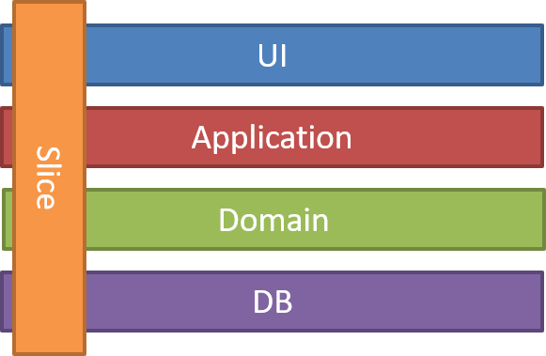
Notes:
While some arhcitectures use technical concern with dependencies flowing innerwards, a nice way is to think of VSA as logic/locality

Slide 11
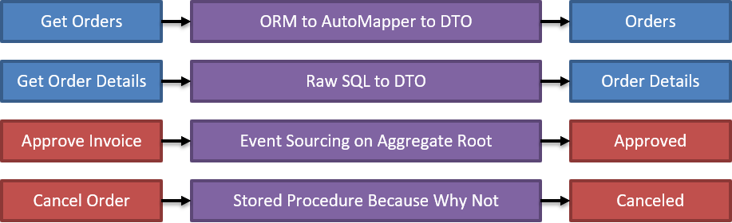
Notes:
While some arhcitectures use technical concern with dependencies flowing innerwards, a nice way is to think of VSA as logic/locality

Slide 12
Vertical Slice Architecture
Domain
Cross cutting concerns
Use Cases
Legend
Darker → wider scope of risk
Lighter → smaller scope of risk
Domain
Feature
Decorator
Domain
Notes:
Darker the green the more risk/reuse.
More risk, probably want more testing
Dependencies flow inwards, so does code as you refactor
Decorator pattern is the OCP part of solid

Slide 13
Minimize coupling between slices and maximize coupling in a slice.
✅ Use EF Core directly in a use case
✅ Repeat code between use cases (not logic)
✅ Infrastructure unaware & pure Domain
✅ Minimal abstraction/defactored use cases – YAGNI!
✅ Pragmatic response to duplication – small services with minimal coupling
❌ DbContext per Use Case
❌ Share NO code at all for VSA purity

Slide 14
Typical Software Architecture
Highly opinionated
Highly abstracted*
Static - i.e., all code must follow a single blueprint
Technical at heart
Notes:
In fact, as early as 2015, Jimmy was talking about SOLID Architecture which is essentially the same thing. It had a few key points (from his slides):
The key points of the SOLID architecture were really applying the principals to achieve a highly cohesive codebase in regard to the Domain specific code (SRP, ISP).
The Domain specific code was then extended (OCP) via cross-cutting concerns - like authentication, authorization & generic logging.
A lot of the outcomes from this talk to me, was allowing a simpler architecture for what matters most - the Domain. The most important thing in software, is that it works. The architecture that allows you to deliver features quickly, is the best architecture for you.

Slide 15
Whereas VSA is
Highly opinionated in development loop
Empowers developers to abstract the right amount
Dynamic – code starts in a use case, and potentially moves all the way to a Domain
Business logic focused/value driven
Notes:
In fact, as early as 2015, Jimmy was talking about SOLID Architecture which is essentially the same thing. It had a few key points (from his slides):
The key points of the SOLID architecture were really applying the principals to achieve a highly cohesive codebase in regard to the Domain specific code (SRP, ISP).
The Domain specific code was then extended (OCP) via cross-cutting concerns - like authentication, authorization & generic logging.
A lot of the outcomes from this talk to me, was allowing a simpler architecture for what matters most - the Domain. The most important thing in software, is that it works. The architecture that allows you to deliver features quickly, is the best architecture for you.

Slide 16
RED
GREEN
REFACTOR
Analyse existing logic
Start a PBI
Merge
VSA
Development loop
Notes:
Darker the green the more risk/reuse.
More risk, probably want more testing
Dependencies flow inwards, so does code as you refactor

Slide 17
Transaction Script
Service Layer
Domain Driven Design
VSA
Code lifecycle
Notes:
Organizes business logic by procedures where each procedure handles a single request from the presentation.
A Transaction Script organizes all this logic primarily as a single procedure, making calls directly to the database or through a thin database wrapper. Each transaction will have its own Transaction Script, although common subtasks can be broken into subprocedures.

Slide 18
Demo
- Simple CRUD

Slide 19
Simple Applications
✅ Keep it super simple
✅ Refactor when needed
✅ Start with transaction scripts
✅ Minimal integration tests for future proofing
✅ Simple coding
❌ Abstract in preparation for maximum DRY
❌ Overthink it

Slide 20
Demo
- Tactical VSA

Slide 21
Complex Applications
✅ Refactor when needed
✅ Abstract when its screamingly obvious
✅ Allow reuse pragmatically
✅ Make decisions based on lead time vs risk
✅ Lots of testing
❌ Abstract in preparation for maximum DRY
❌ Overthink it

Slide 22
Agenda
History of VSA
Theory in depth
Demo – Simple CRUD
Demo – Tactical VSA
When should I pick VSA?
Conclusion

Slide 23
If your team does not understand when a "service" is doing too much to push logic to the domain, this pattern is likely not for you.

Slide 24
If your team does understand refactoring, and can recognize when to push complex logic into the Domain, you'll find this style of architecture able to scale far past the traditional layered/concentric architectures.

Slide 25
Agenda
History of VSA
Theory in depth
Demo – Simple CRUD
Demo – Tactical VSA
When should I pick VSA?
Conclusion

Slide 26
Resources
https://github.com/Hona/VerticalSliceArchitecture ⭐
https://github.com/Hona/VerticalSliceArchitecture.Samples.Todos
https://github.com/Hona/VerticalSliceArchitecture.Samples.EventSourcingMartenDB
https://lukeparker.dev/tags/vertical-slice-architecture
https://www.jimmybogard.com/vertical-slice-architecture/
https://awesome-architecture.com/vertical-slice-architecture/

Slide 27

Presentation & links

Slide 28
Thank you!
Any questions?

Slide 29
Branding – Cheat Sheet
Typography
Color Guide
Headings: JetBrains Mono Thin
Body: Open Sans
Primary: #EF476F
Secondary: #06D6A0
Tertiary: #FFD166
Body: #FFFFFF
Background: #192E39
Accent Background: #26547C
Surface: #1E3B4A

